Slide 1
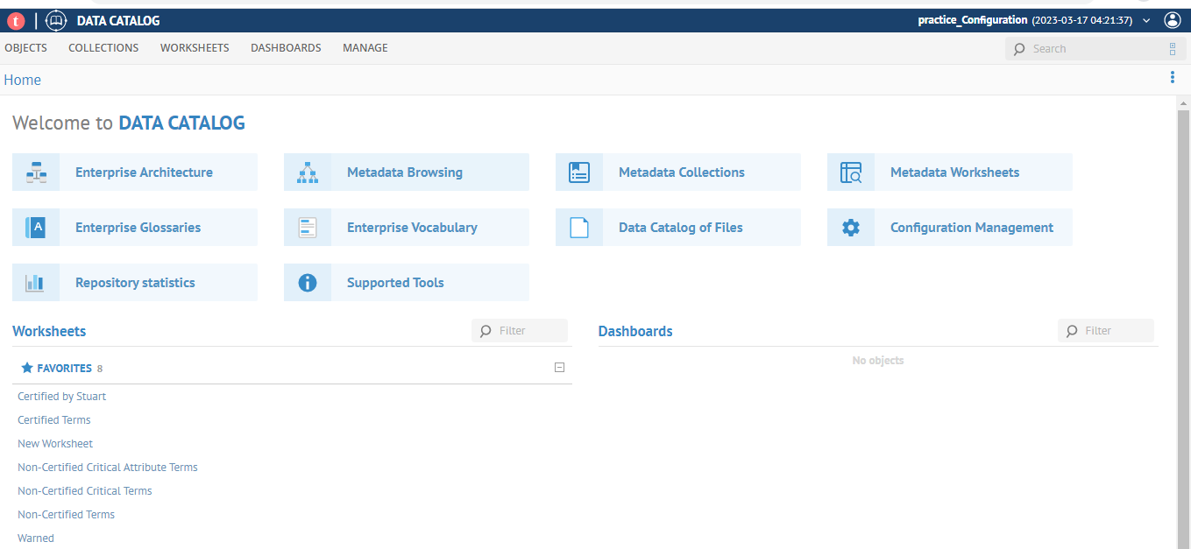
Introduction to talend data catlog

Slide 2
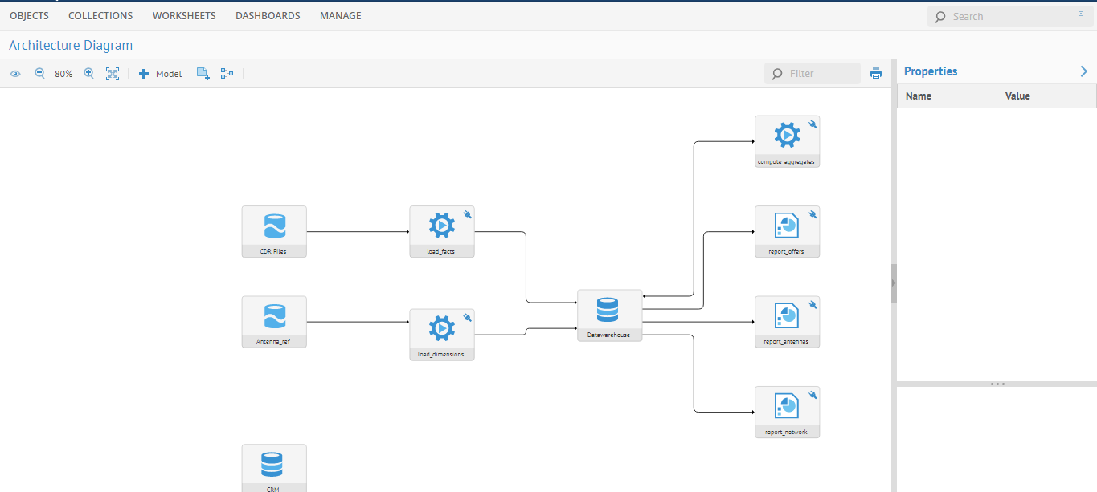

Slide 3
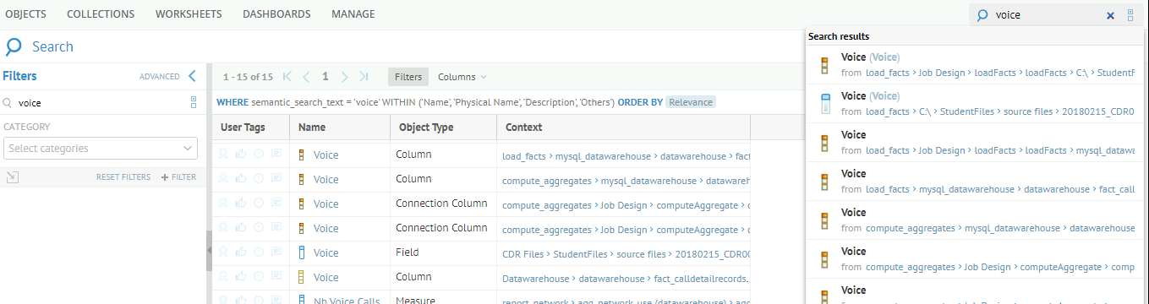
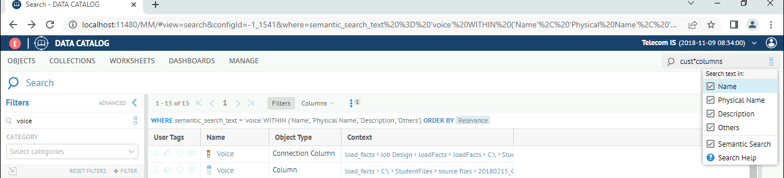

Slide 4
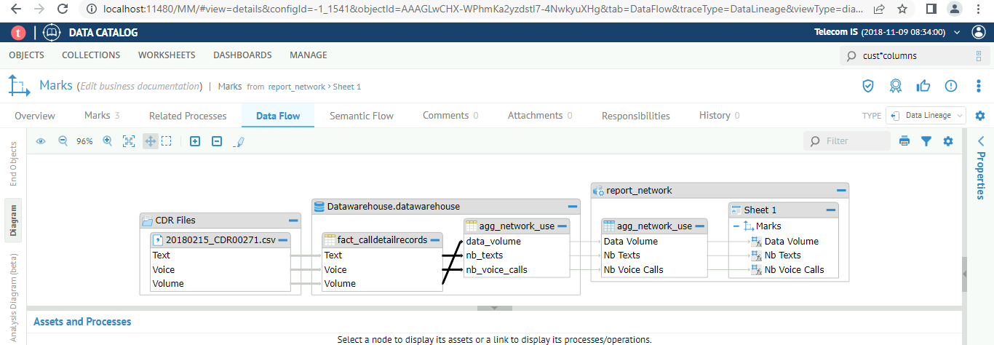
Tracing data lineageTracing data lineage
WORKSHEETS > Tableau > Workbooks.
Click Sheet 1 in the Worksheets panel.
Click the Marks tab then select Marks in the Marks panel.

Slide 5
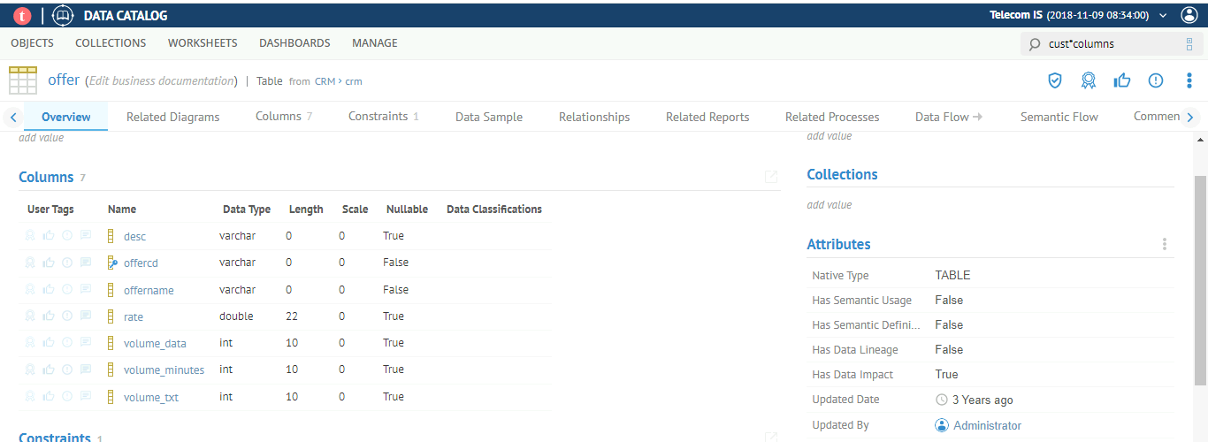
Tracing data lineageTracing data impact (forward lineage)
Select WORKSHEETS > Database > Tables
Click the offer table that is from the CRM > crm context.
To trace the impact of the offername column, right-click the CRM.crm offername and select Trace Data Impact.

Slide 6
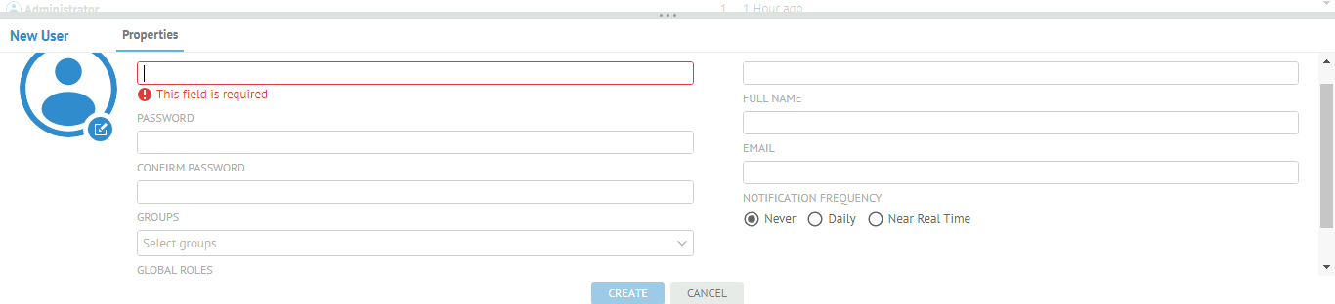
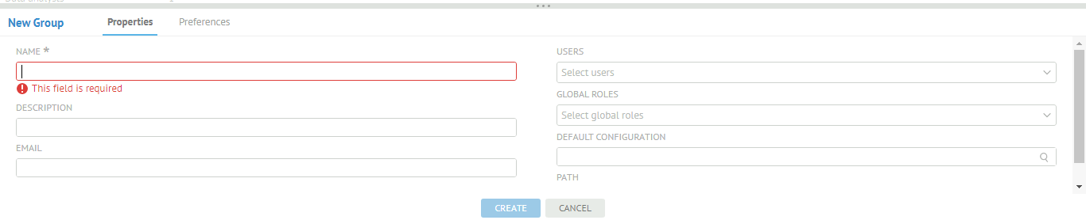
psDefining users and groups
In the Data Catalog interface, click MANAGE > Users.
Click MANAGE > Groups.

Slide 7
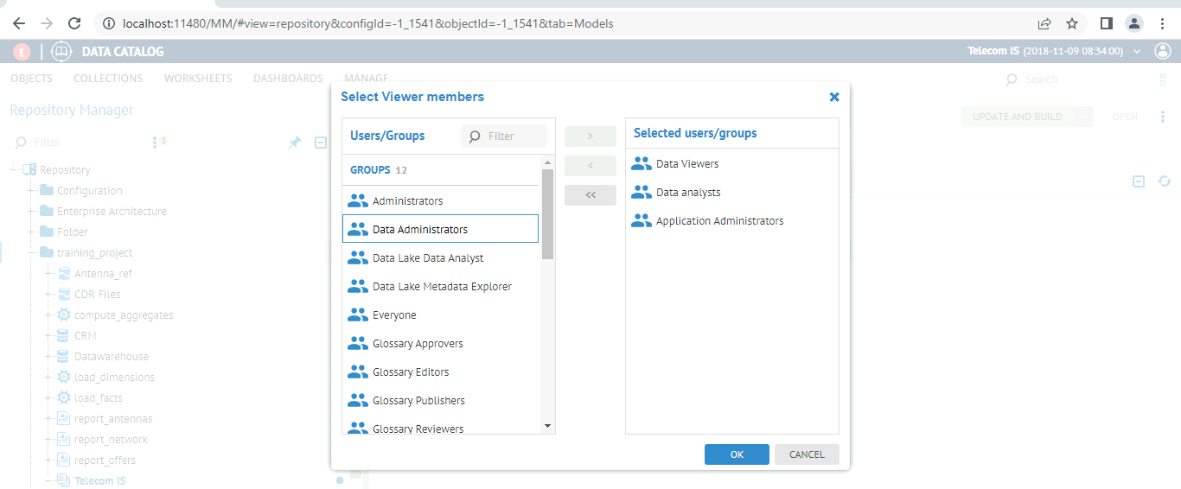
p
psGranting repository access
In the Data Catalog interface, click MANAGE > Repository.

Slide 8
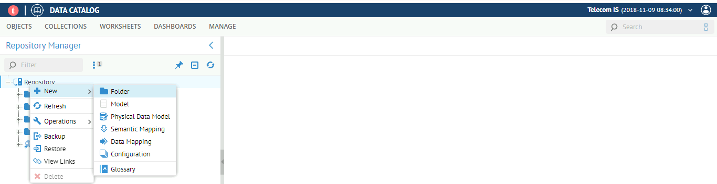
psHarvesting metadata from flat files
Log in to Talend Data Catalog interface as an Administrator with the password Administrator.
If prompted to select a configuration, select Telecom IS.
Select MANAGE > Repository
In the Repository Manager view, expand Repository, right-click Repository, then select New > Folder

Slide 9
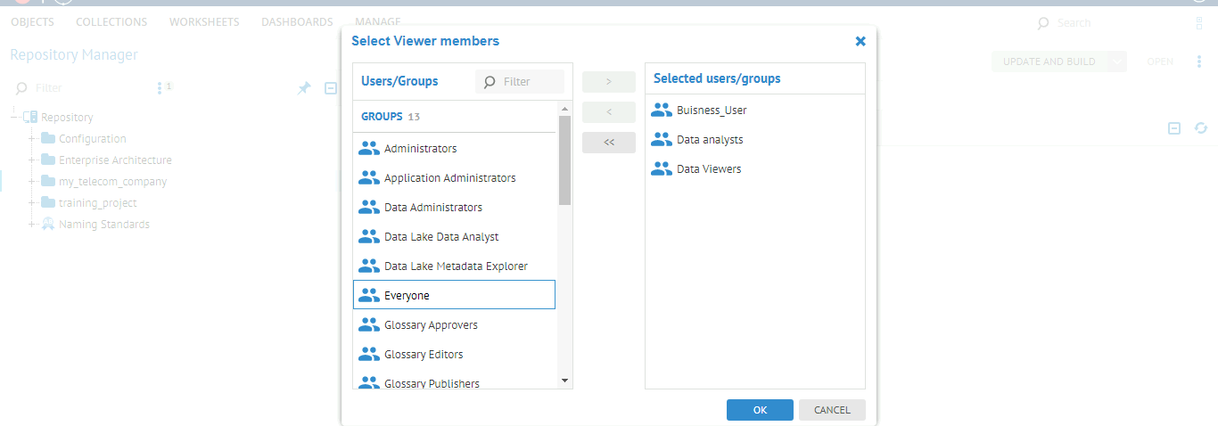
Right-click the new my_telecom_company folder and select Edit Responsibilities.
In the Edit Responsibilities window, click the EDIT button in the VIEWER section.
Grant Viewer access to Data analysts and Business Users then click OK.

Slide 10
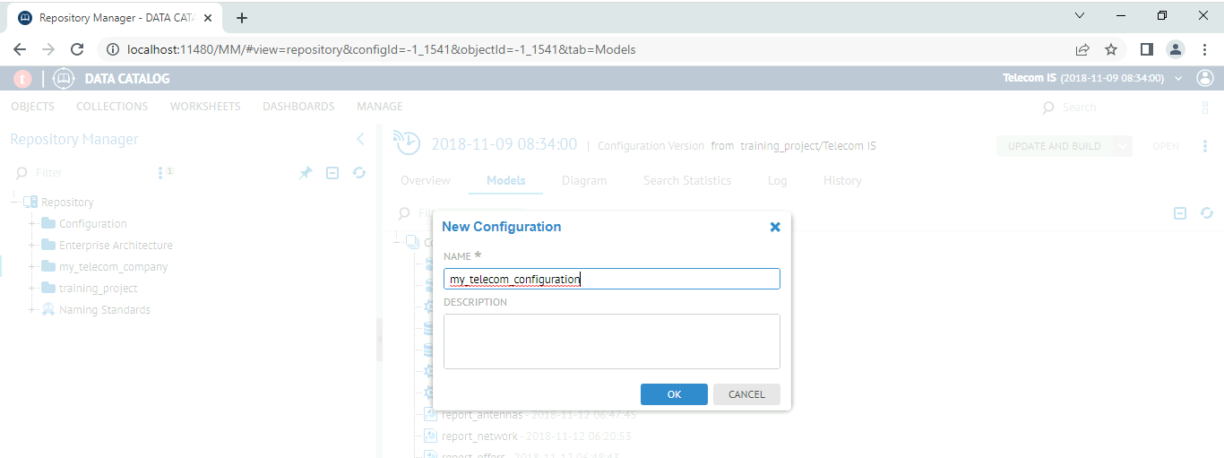
Right-click the my_telecom_company folder again and select New > Configuration.
In the New Configuration window, name the configuration my_telecom_configuration and click OK.

Slide 11
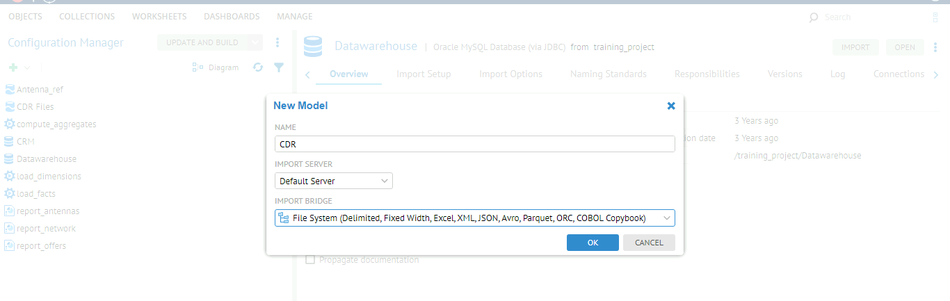
Harvesting CSV files
MANAGE > Configuration.
In the Configuration Manager view, click the + icon and select Model.
Click the Import Setup
Click the Import Options
Click the IMPORT button to start harvesting.
Click the HIDE button.

Slide 12
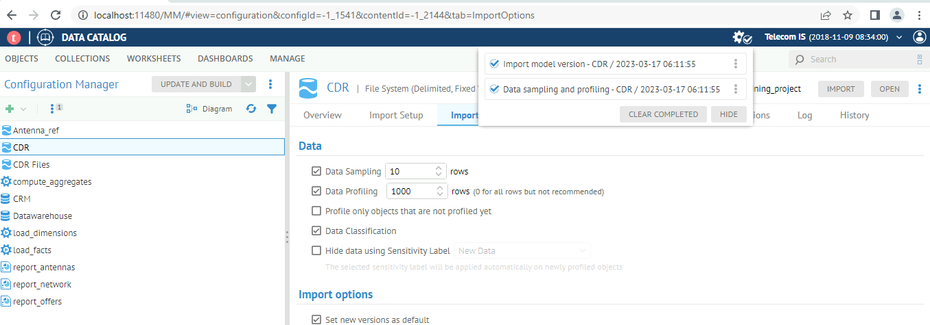

Slide 13
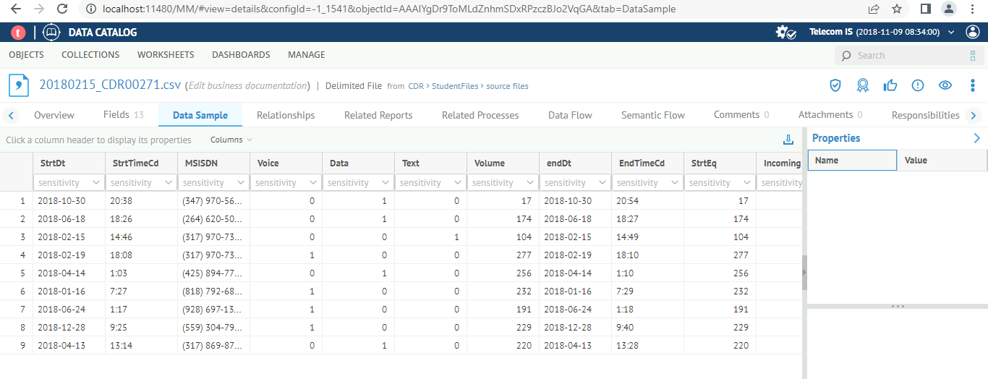
Verifying the harvesting and sampling of data collected
To access the model you just harvested, select WORKSHEETS > Categories > File > Files.

Slide 14
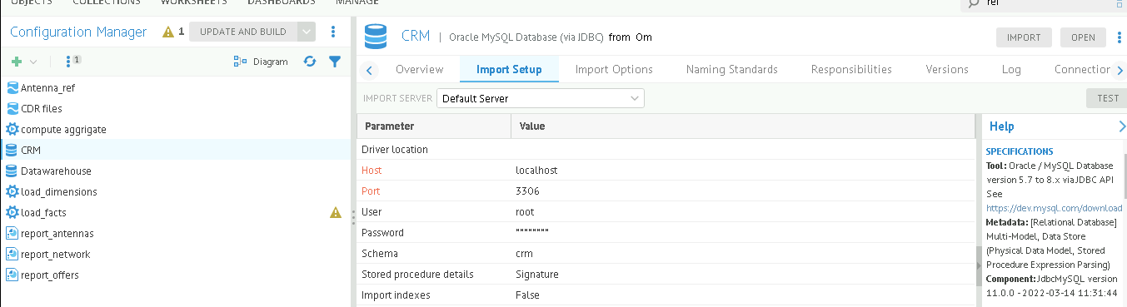
Harvesting from databases
MANAGE > Configuration.
In the Configuration Manager view, click the + icon and select Model.
Click the Import Setup
Click the Import Options
Click the IMPORT button to start harvesting.
Click the HIDE button.

Slide 15
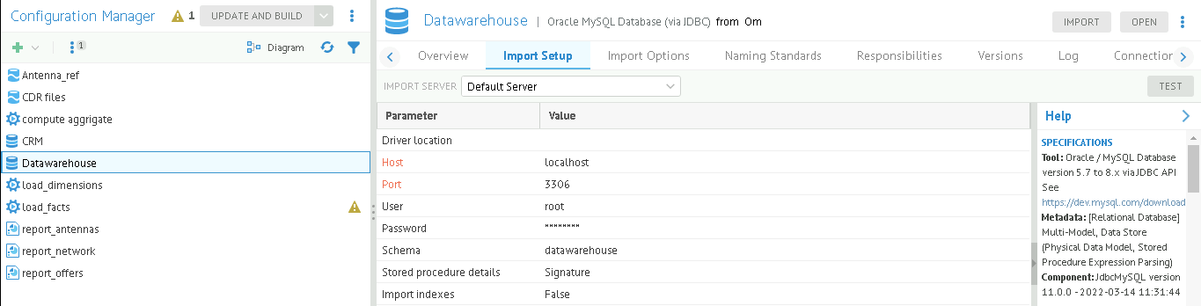
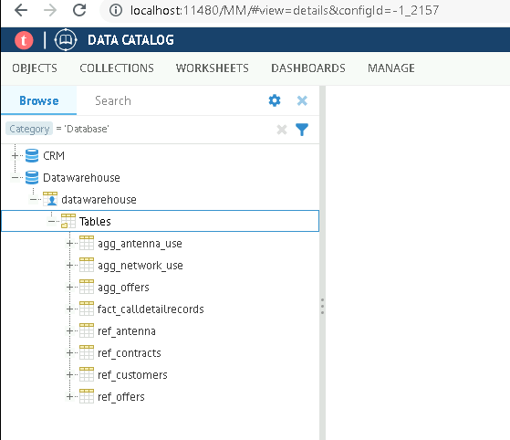
harvesting the data warehouse database

Slide 16
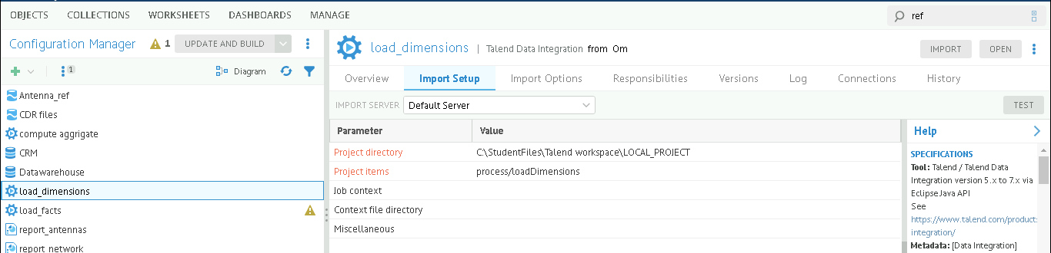
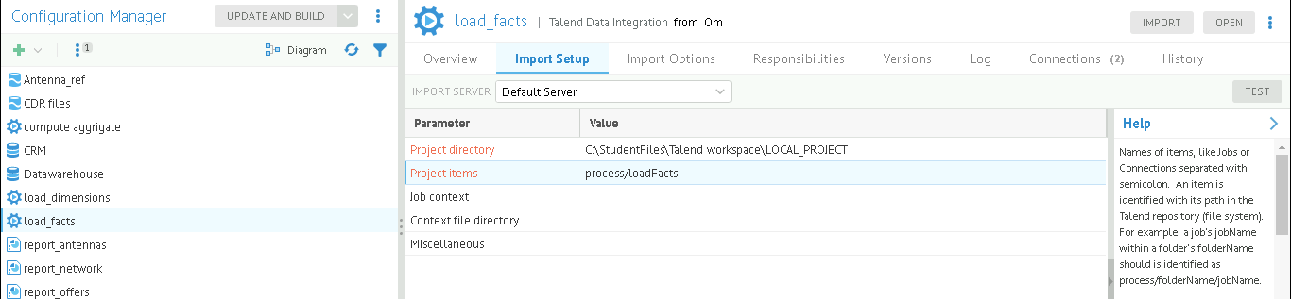
Harvesting from Data Ingestion Jobs

Slide 17
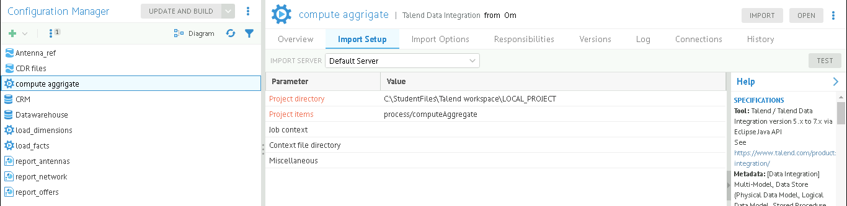

Slide 18
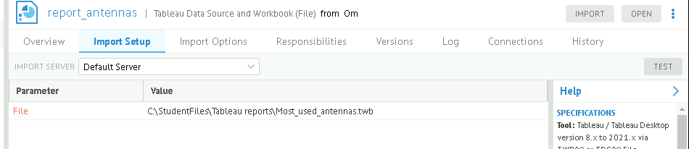
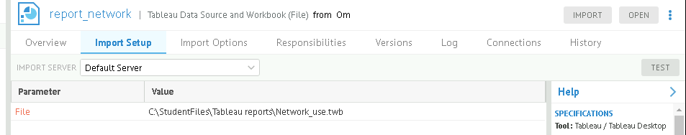
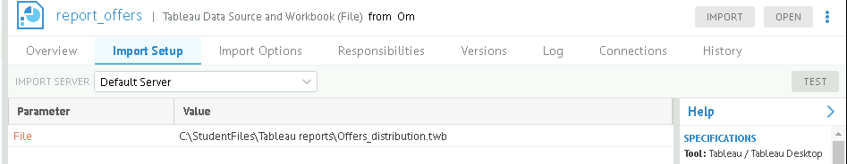
Harvesting from Tableau reports

Slide 19
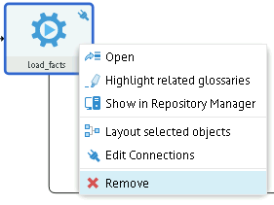
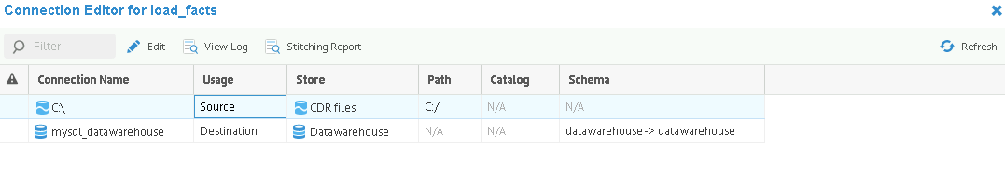
Stitching metadata
Right-click the load_facts element and select Edit Connections.

Slide 20
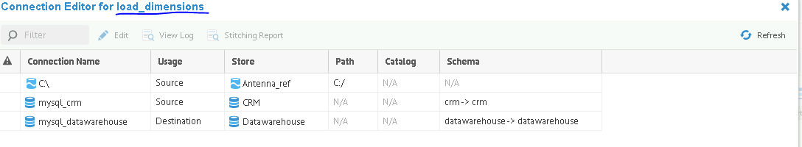
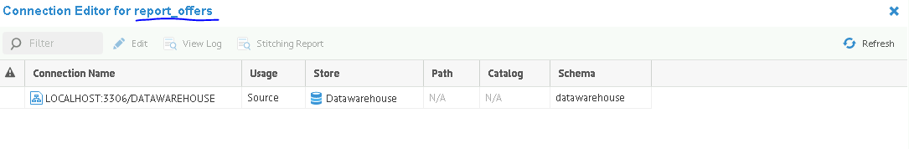
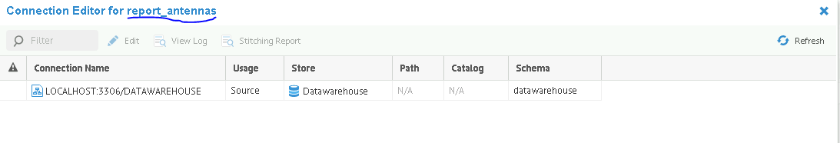
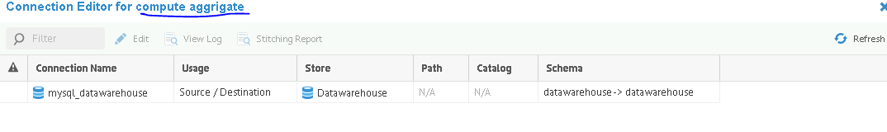

Slide 21
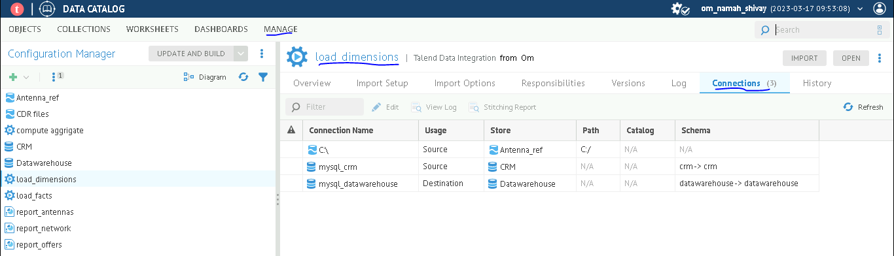
Building the configuration
Identifying stitching issues
Select MANAGE > Configuration.
Check the source and destination file for each component
Do this for all warning components.
Update and build (it will remove all the warnings of components)

Slide 22
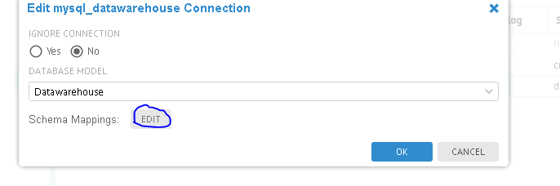
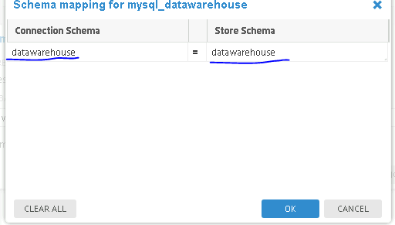

Slide 23
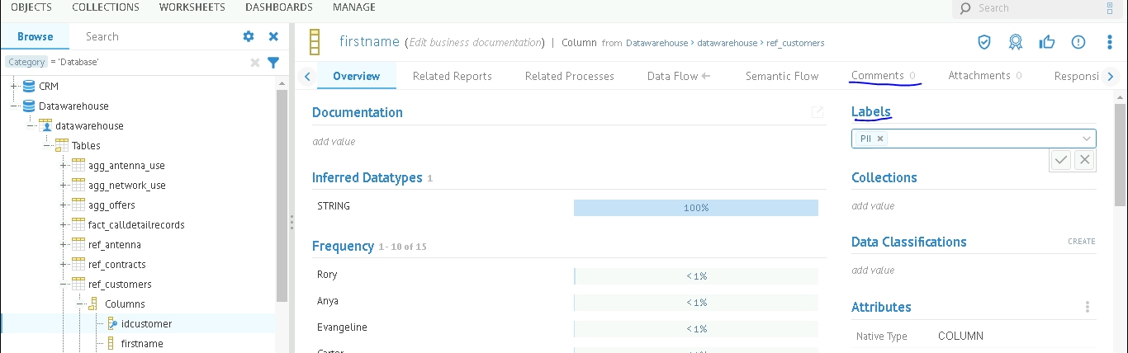
Documenting a model with labels
Select OBJECTS > Database.
Expand the Datawarehouse model and navigate to Tables > ref_customers > Columns
Here we can add the the labels and comments for each table to identify immedietly.

Slide 24
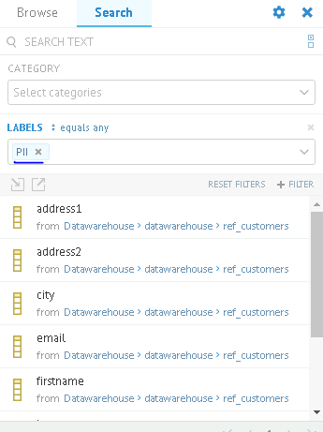
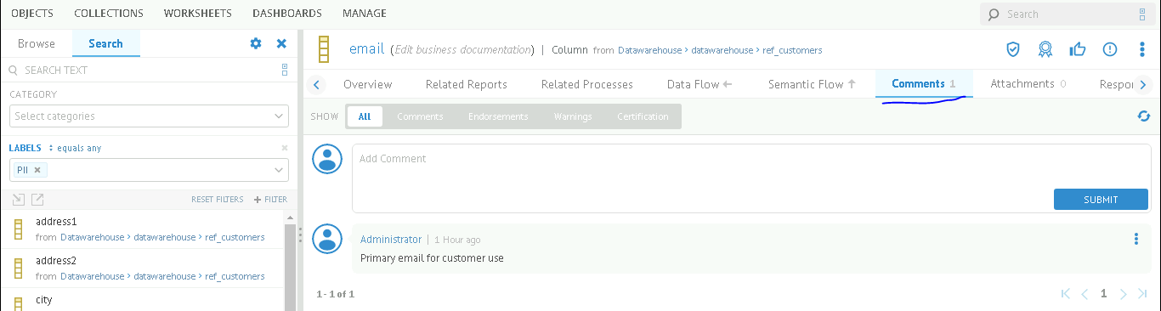

Slide 25
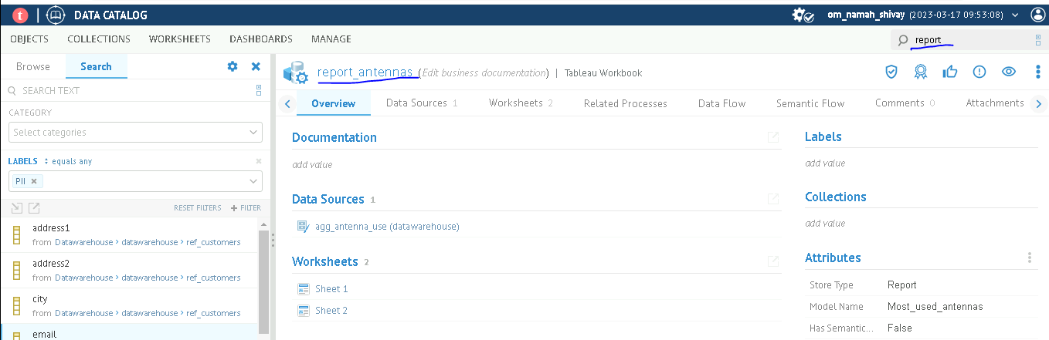
Documenting a model using attachments
In the search field, enter report_
Select report_anteena select Attachments
Upload a image files

Slide 26
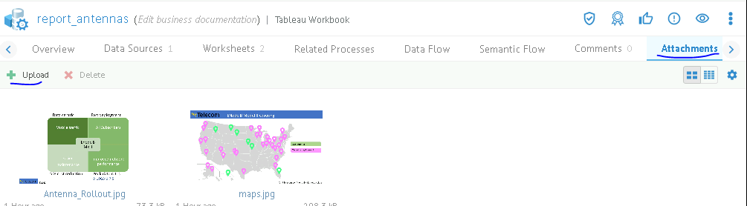
Using custom attributes
To manage custom attributes, select MANAGE > Metamodel.
Cretae the attributes and add to objects.
Start editing.
Stop editing after done.

Slide 27
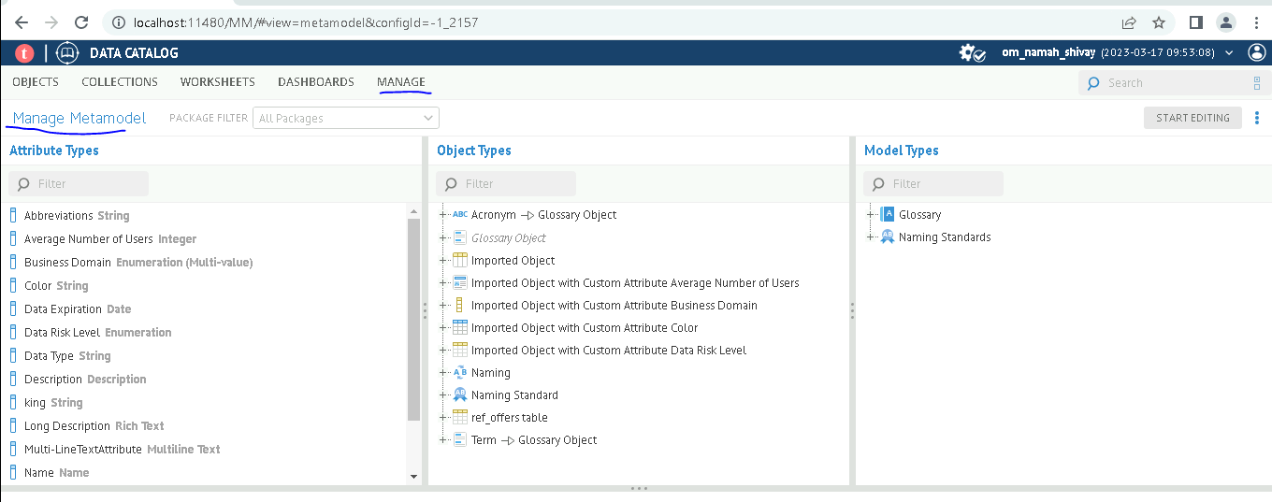

Slide 28
